Slide 1

Mahek Intekhan Alam Inamdar (505)
Madhura Anil Sawant(520)

Slide 2
PROBLEM SELECTION
Hydroponic Farming
Earthquake Detector Alarm
Automatic Streetlight
Rain Water Harvesting
Road Accident Prevention System

Slide 3
Finalization of Problem
Road accident prevention system
PROBLEM STATEMENT:-
Road accidents continue to be a leading cause of death disabilities and hospitalization in the country despite our comment and efforts.
If somebody is going by to two lane road from his/her left side so the front person is expected to cross by right side (his left) side. It is not so it may lead to accident.
SOLUTION:-
If the vehicle is coming wrong way our safety device will put a barrier to the vehicle this will help to mitigate the accidents.

Slide 4
ADVANTAGES AND DISADVANTAGES
DISADVANTAGES
ADVANTAGES
Main advantage: prevent over- speeding thus minimize in accident.
Gives a changes for pedestrians to cross the roads.
Not only accident but also huge damage for vehicle are lies and to cover them they had to pay thousands.
Reducing accident and saving lives on roads .
Reduced head on and intersection crashes.
Every vehicles are supposed to break their speed to cross speed breakers safely this is major disadvantage for emergency vehicle like ambulance, fire brigades, etc.
Implementation compleraty.
Resource to change.
Resistance to change.
Potential overemphasis on infrastructure.

Slide 5
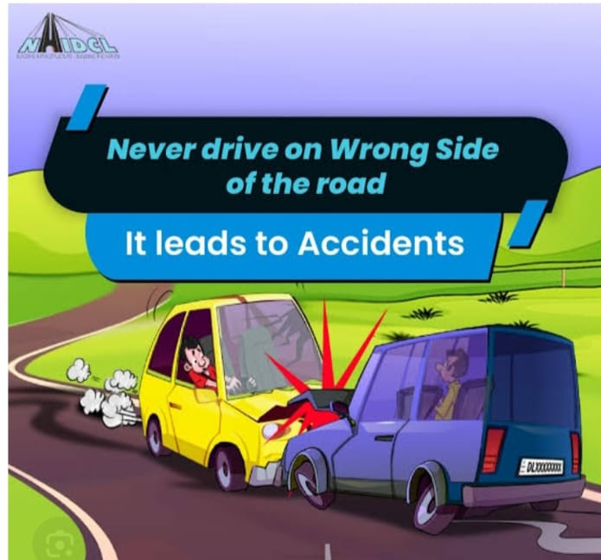
Customer Survey Feedback Form If the vehicle is coming wrong way our safety will put a barrier to the vehicle this will help to mitigate the accidents.
Email :

Slide 6
1.Does the product is useful for mitigation due to accidents due to wrong side driving?
⃝ Yes ⃝ No
2.Do you feel our product work softly?
⃝ Yes ⃝ No
3.Do you feel our product is sustainable?
⃝ Yes ⃝ No
4. Is any funding is available by government for this product?
⃝ Yes ⃝ No
5. Do you feel our product will harm the environment?
⃝ Yes ⃝ No
6.Does climatic conditions affect on the product?
⃝ Yes ⃝ No

Slide 7

7. Which condition affect the most?(Heavy rains or extreme heat)
8.What is expected lifespan of our product?
9. How would you rate the product?
1 2 3 4 5
10.Suggest your ideas to improve the product.

Slide 8
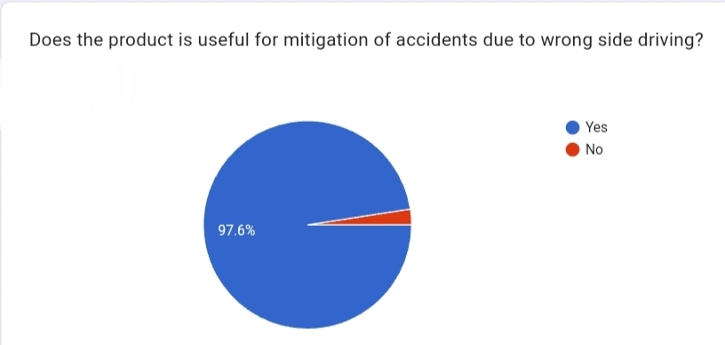
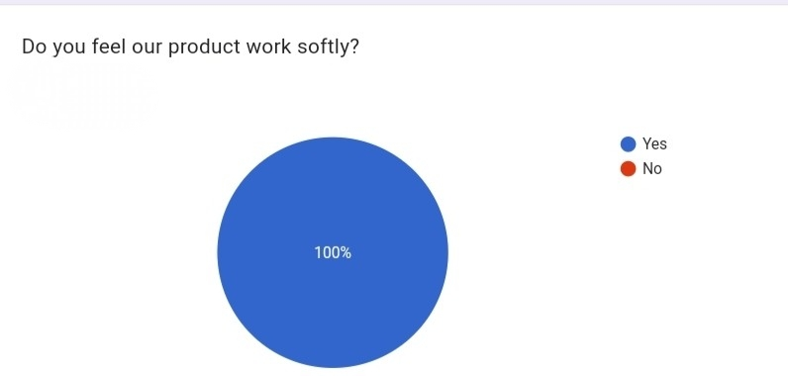
FEEDBACK ANALYSIS

Slide 9
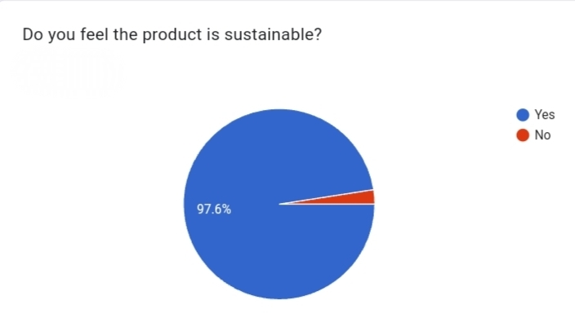
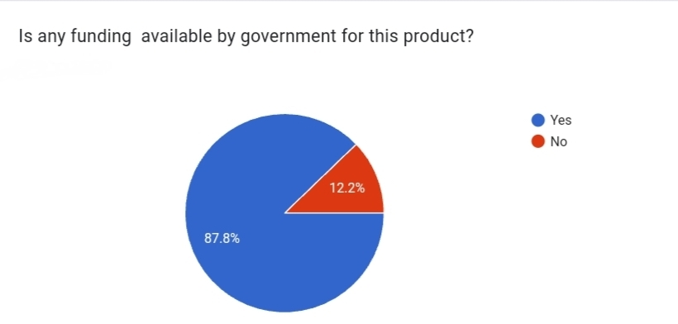

Slide 10
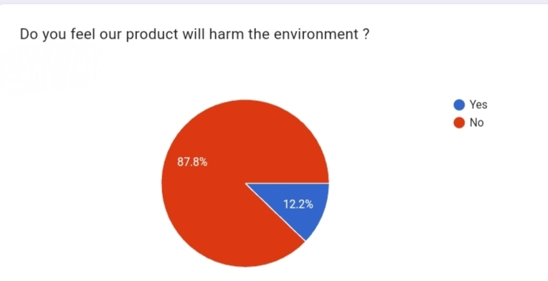
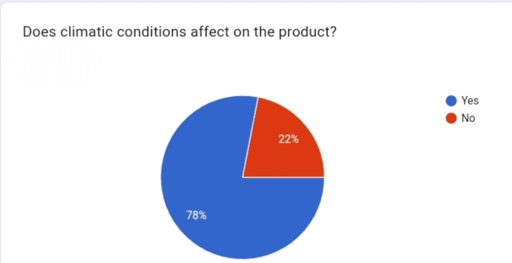

Slide 11
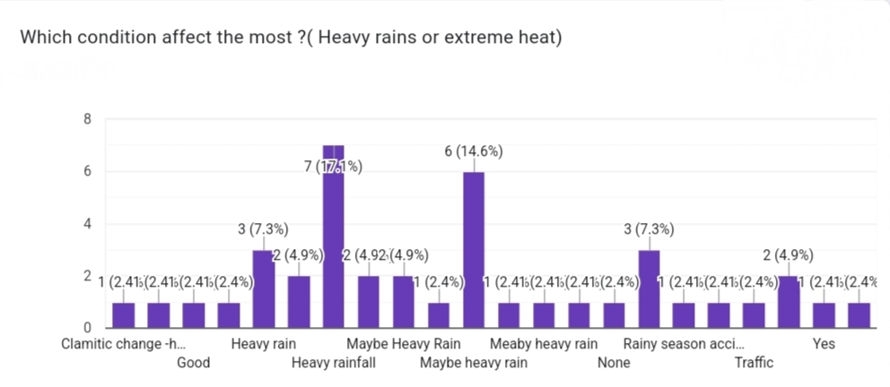
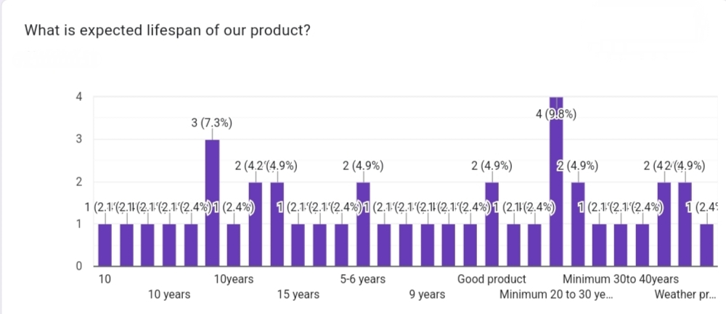

Slide 12
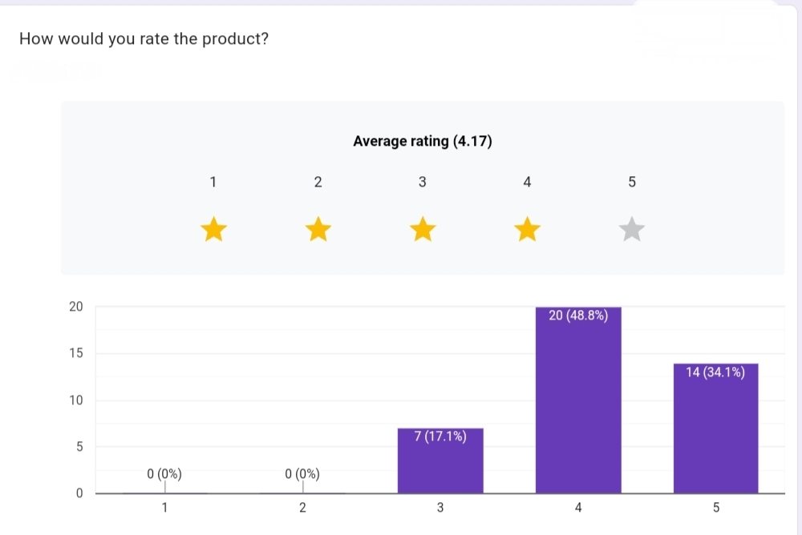
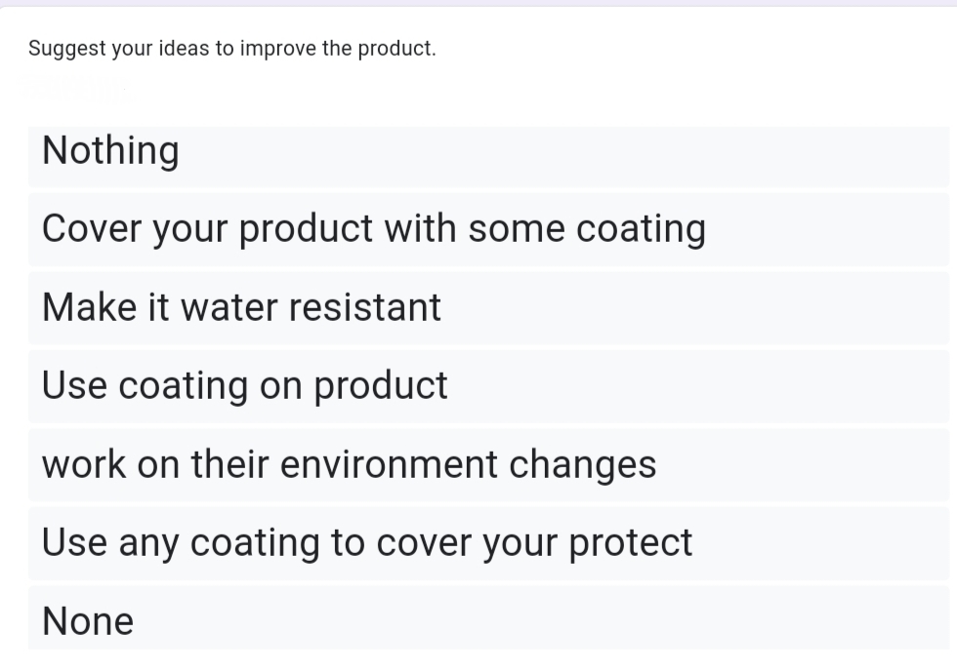

Slide 13
PERSONA-BUILDING
INTRODUCTION
Road accidents continue to be a leading cause of death disabilities and hospitalization in the country despite our commitment and efforts.
As per the report a total number of accident 1.7 lakh road accidents have been reported in the year 2023.
If somebody is going by two lane road from his/her left side so the front person is expected to cross by right side (his left side). It is not so it may lead to accident.

Slide 14

Name : John Williams Age : 38 Occupation : Public Safety Advocate Location : Suburban area, frequently drives on highways and in urban setting Driving Experience : 15 years Demographics Gender : Male Income : 60k Education : Bachelor’s in Public Health

Slide 15
ONLINE BEHAVIUOR
FRUSTRATION
Actively participates in forums and social media groups related to road safety and urban planning.
Consumes educational content, such as blog, videos and infographics about accident prevention.
Engages with local government websites and apps that promotes safety.
Distraction : John often gets distracted by his phone and work related calls, which makes him anxious about not fully focusing on the road.
Heavy traffic : When there is heavy traffic, especially during peak hours, it can cause delays and create a sense of frustration.
Limited passing zones : Two-lane roads often lack designated passing lanes, which means you may get stuck behind a slower vehicle for a long time, especially on winding or hilly roads

Slide 16
MOTIVATIONS
INFLUENCES
Ensuring a safe driving environment for his family.
Staying updated with advanced driving technologies that enhance safety.
Reducing driving stress, especially in challenging conditions ( heavy traffic, adverse weather, etc.)
Interested in technologies that can reduce the accidents, particularly those caused by distractions or human error.
Around two weeks ago, John was going on two lane road.
A car coming from his front side overtaking a truck. While overtaking a car came in front of his car and they meet with an accident but there was no huge loss.
He want sensor or a product which stop vehicle who are on wrong side.

Slide 17
NEEDS
Reliability : Expects the system to function consistently, especially in high-risk situations (e.g. automatic emergency braking when a vehicle suddenly cuts in)
Ease of use : A simple, easy to understand interface for system settings. John needs to quickly adjust settings (e.g. sensitivity of collision warnings) without confusion.
Education : Would like some guidance or training on how the system works, ideally through tutorials or in vehicle prompts

Slide 18
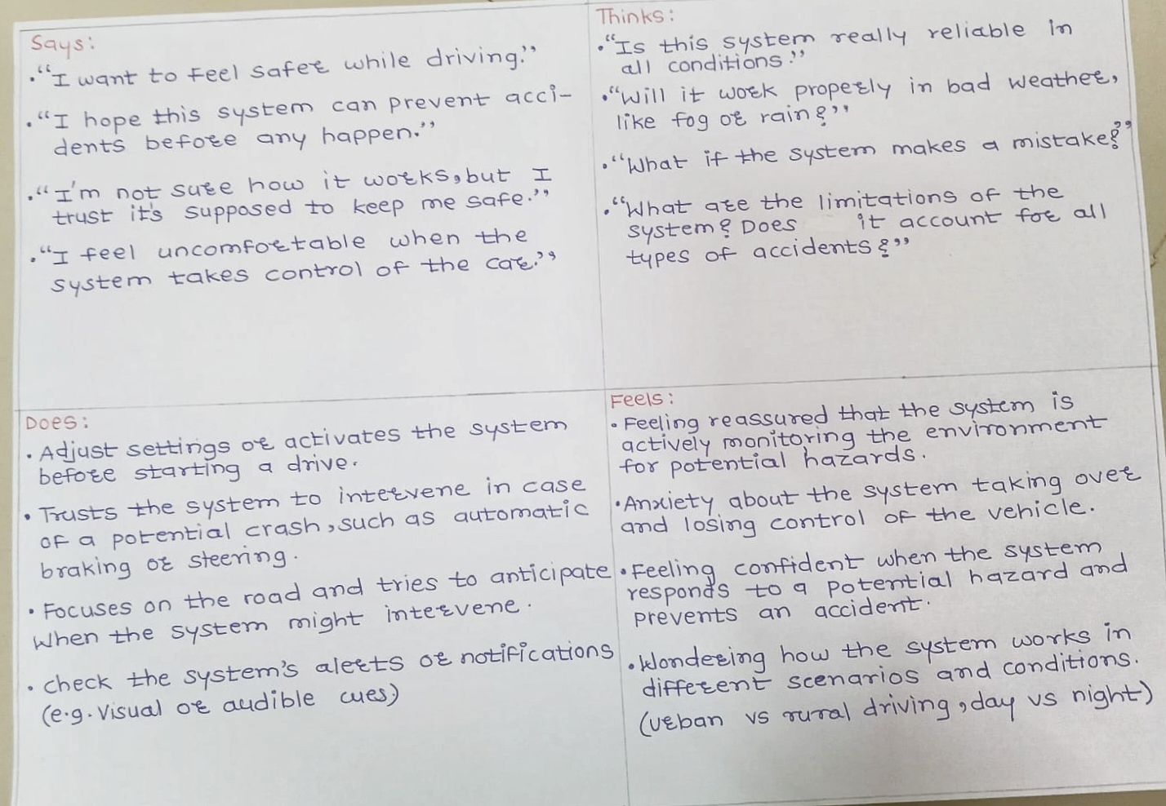
EMPATHY MAP

Slide 19
 | Awarenss | Research | Consideration | Construct | Post Constuct
Customer | John Williams(38)is an public safety advocate. | Conduct surveys to understand driving habits and awareness and concerns | Improve road infrastructure in high-risk zones | Launch public awareness campaigns | Use tools like surveys ,public satisfication
Thoughts | Road accidents can happen to anyone | What tools or apps can helps? | How much effort does this requires? | How will this affect my daily routine? | Has this reduced my risk?
Feelings | Curiosity about personal safety | Confusion about options | Reassurance from success stories | Determination to improve safety | Satisfied from reduced risks
Action | Haring and discussing safety campaigns with peers | Downloading safety apps | Attending workshops, Speaking with experts | Consistently using safety tools | Sharing personal experiences
Pain points | Difficulty identifying credible sources | Limited localized data | Lack of community participation | Time required to learn and adapt | Feeling isolated if others don’t participate
Touch points | News reports oe accident statistics | Apps promoting safe driving behaviour | Road safety workshops | Installation of safety tools | Regularly reading updates on safety initiatives

Slide 20
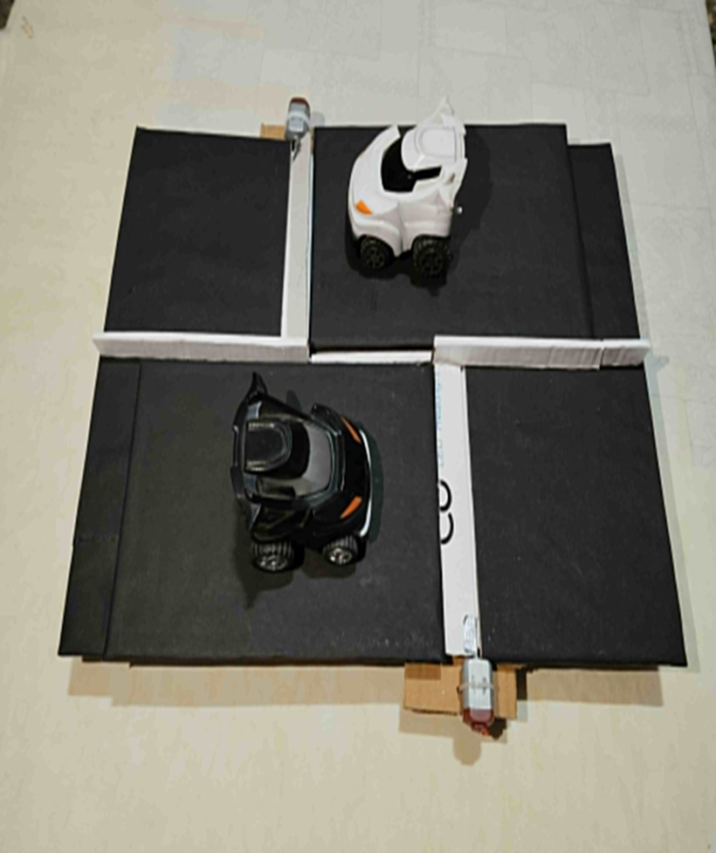
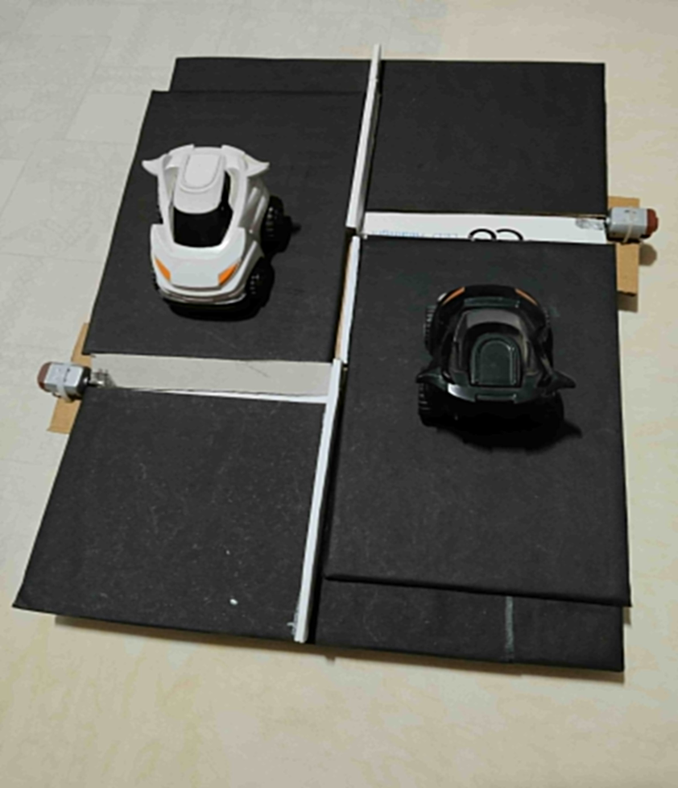

Slide 21


